Slide 1
C++ Programming:
Problem Solving and Programming
Chapter 4
Operators and Expressions

Slide 2
Objectives
Operators and Expressions
  Understand and use the arithmetic, relational and logical operators.
  Understand and use the assignment operators and expressions.
Notes:
BACS1014 Problem Solving and Programming

Slide 3
Expressions
A sequence of operands and operators that reduces to a single value.
No limit to the number of operators and operands in an expression.
An operator is a syntactical token that requires an action to be taken. ( +, -, *, /, % …).
An operand receives an operator’s action.

Slide 4
Expressions
E.g. expression: 3 + 6 - 4
Can be simple (contains only one operator) or complex (contains more that one operator).
E.g. simple expression → 2 + 5
E.g. complex expression → 7 + 12 * 3
Operator
Operand

Slide 5
Types of Operators
Arithmetic operators
Assignment operators
Increment and decrement operators
Relational operators
Logical operators
Ternary conditional operators

Slide 6
Arithmetic Operators
C++ Operation | Arithmetic operator | C++ Expression
Addition | + | 5 + 2 is 7 5.0 + 2.0 is 7.0
Subtraction | - | 5 – 2 is 3 5.0 – 2.0 is 3.0
Multiplication | * | 5 * 2 is 10 5.0 * 2.0 is 10.0
Division | / | 5.0 / 2.0 is 2.5 5 / 2 is 2
Modulus (remainder) | % | 5 % 2 is 1
Avoid
Integer Division

Slide 7
To prevent integer division:
Example 1:
double comm,sales;
sales = 1000.00;
comm = 6/100*sales;
Example 2 (Use of cast operator):
int num1=12, num2=5;
double total;
total =num1/num2;
comm = 6/100.0*sales;
total =(double)num1/num2;

Slide 8
Assignment Operators
Evaluates the operand on the right side of the operator (=) and places its value in the variable on the left.
The left operand must be a single variable.
a = b + 10;
temperature = 98.6;
count = count + 2;

Slide 9
Assignment Operators
Simple assignment – found in algebraic expressions.
x = 9;
y = x + 10;
z = y * x;
Multiple assignment
a = b = c = d = e = 100;
  The assignment associates from right to left
Assignment within another calculation. value = 5 + (s = 5 - a)

Slide 10
Assignment Operators
Compound assignment - A shorthand notation for a simple assignment.
Requires the left operand be repeated as a part of the right expression.
Five compound assignment operators:
    *= %= -=
    /= +=
E.g.
x *= y + 5 evaluated as x = x *( y + 5 )

Slide 11
Compound Assignment
Compound Assignment | Equivalent Simple Assignment
x += y | x = x + y
x -= y | x = x - y
x *= y | x = x * y
x /= y | x = x / y
x %= y | x = x % y
x *= y+1 | x = x * (y+1)

Slide 12
Precedence and Associativity
Precedence is used to determine the order in which different operators in a complex expression are evaluated.
Associativity is used to determine the order in which operators with the same precedence are evaluated in a complex expression.

Slide 13
Order of Precedence
All operations inside of parenthesis ( ) are evaluated first
The higher precedence operators in the table will be performed first as compared to the lower ones (refer the table on next slide)
When operators are on the same level
  Perform from left to right

Slide 14
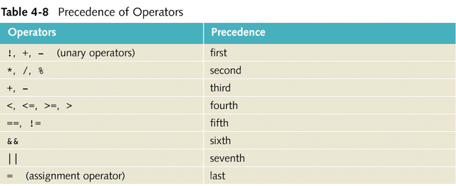
Order of Precedence

Slide 15
Order of Precedence - Example
Example
  (2 + 3) * 4 = 20
  2 + 3 * 4 = 14
  3 * 8 % 5 / 2 = 2
  10>90 && 5<8 || 1 = 1

Slide 16
Types of Associativity
It evaluates the expression by starting on the left and moving to the right
It evaluates the expression by proceeding from the right to the left
a) Left associativity:
b) Right associativity:

Slide 17
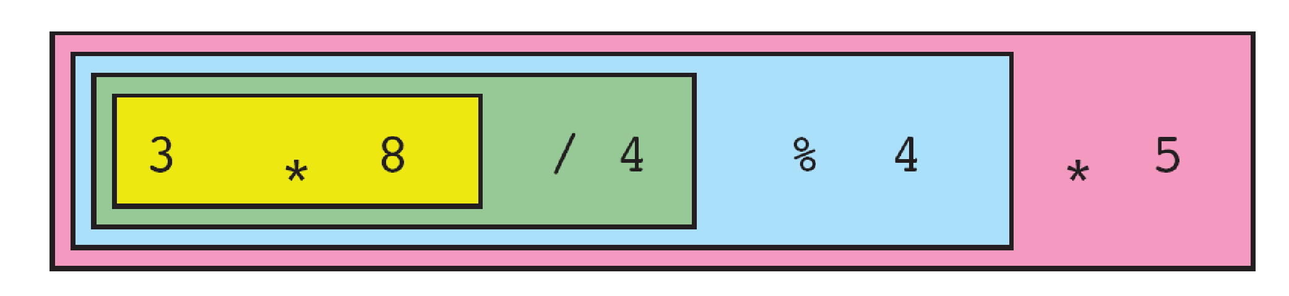
Left Associativity
3 * 8 / 4 % 4 * 5

Slide 18
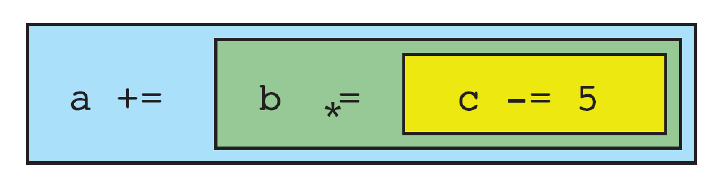
Right Associativity
a += b *= c -= 5
a = a + b = b * c = c - 5

Slide 19
Types of Associativity - Example
If a=3, b=5, c=8;
a+=b*=c-=5;
So,
a= a+ (b= b* (c= c-5 )))
a= 3+ (b=(5* (c= 8-5 )))
=18

Slide 20
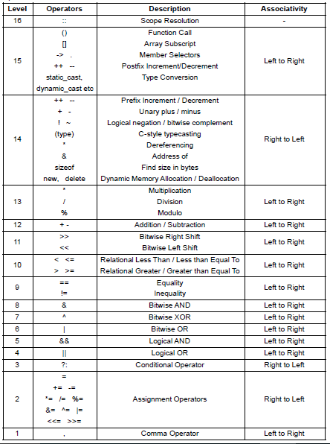
Operators precedence and associativity in C++

Slide 21
Increment & Decrement Operators
Increment operator (++):
- increment the value of a variable by 1
Decrement operator (--):
- decrement the value of a variable by 1
Prefix & Postfix expression:
Prefix-increment: ++variable
Postfix-increment: variable++
Prefix-decrement: --variable
Postfix-decrement: variable--

Slide 22
Increment & Decrement Operators
Note :
(++a) and (a++) has the same effect as (a = a + 1)

Slide 23
Prefix & Postfix Expression
Prefix expression:
The effect of increment/decrement is seen when the current statement is evaluated
Postfix expression:
The effect of increment/decrement is seen after the current statement is evaluated

Slide 24
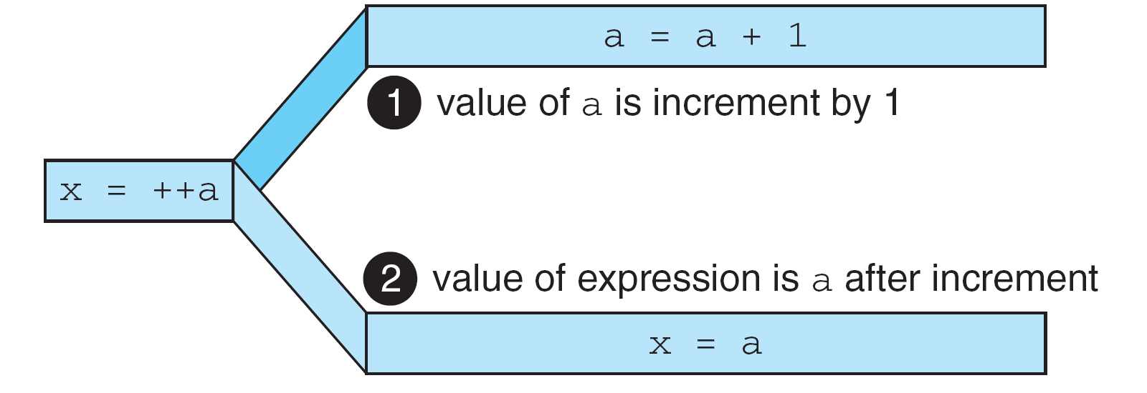
Prefix Expression
FIGURE 4-6 Result of Prefix ++a

Slide 25
Prefix Expression - Examples
1. int a, b = 5, c, d = 10;
c = ++d;
a = --b;
cout << “a= ” << a << “, b= ” << b << “, c = ” <<
c << “, d = ” << d;
a=4, b=4, c=11, d=11

Slide 26
Prefix Expression - Examples
2. a = 5;
  b = 10;
  cout << “a= ” << a << “, b= ” << b << endl;
  cout <<“++a = ” << ++a << “--b= ” << --b << endl;
  cout << “a= ” << a << “, b= ” << b << endl;
a=5, b=10
++a=6, --b=9
a=6, b=9

Slide 27
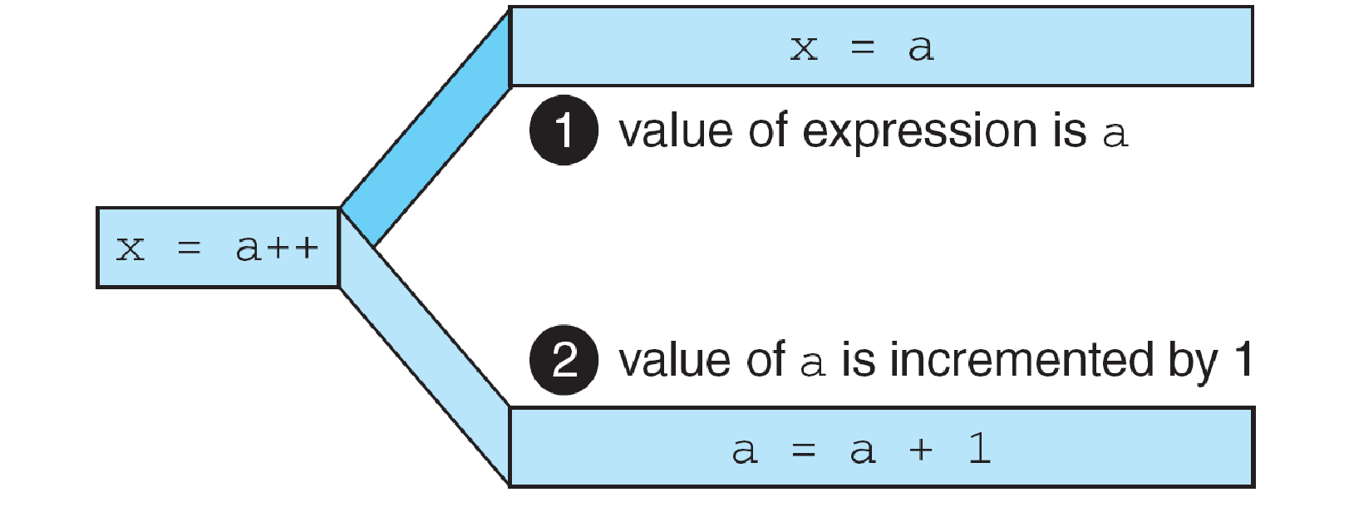
Postfix Expression
FIGURE 4-8 Result of Postfix a++

Slide 28
Postfix Expression - Examples
int a, b = 5, c, d = 10;
c = d++;
a = b --;
cout << “a= ” << a << “, b= ” << b << “, c = ” <<
c << “, d = ” << d;
a=5, b=4, c=10, d=11

Slide 29
Postfix Expression - Examples
a = 5;
  b = 10;
  cout << “a= ” << a << “, b= ” << b << endl;
  cout <<“a++= ” << a++ << “b--= ” << b-- << endl;
  cout << “a= ” << a << “, b= ” << b << endl;
a=5, b=10
a++=5, b--=10
a=6, b=9

Slide 30
Exercise
int x=6, y=20, a, b;
a=y++;
b=--x;
cout << “a= ” << a << “, b= ” << b << endl;
cout << “x= ” << x-- << “, y= ” << ++y << endl;
a=--b;
cout << “x= ” << x << “, y= ” << y << endl;
cout << “a+b=” << a+b << “, b= ” << b << endl;
a=20, b=5
x=5, y=22
x=4, y=22
a+b=8, b=4

Slide 31

Exercise
Given the following:
int x=9, y=5, z=31, m=1234;
Find the value of the following expressions. Assume all the
questions are independent (not related).
a) x++ + y++
b) ++x - --z
c) z – (x + z) % 2 + 4
d) x – 4 * (3 + z) + y
e) (m/10) % 10
a) 14
b) -20
c) 35
d) -122
e) 3

Slide 32
Relational Operators
Always produces a TRUE(nonzero) or FALSE (0) result.
E.g.
int a = 5, b =10, c = 15, d = 5;
  a > b
  ( return 0)
  b >= a b < c d <= b c > a
( all return nonzero value )

Slide 33
Relational Operators
Relationship | Operator
Equal to | ==
Not equal to | !=
Greater than | >
Greater than or equal to | >=
Less than | <
Less than or equal to | <=
e.g. if(mark > 100)
cout << “invalid”;
Notes:
BACS1014 Problem Solving and Programming

Slide 34
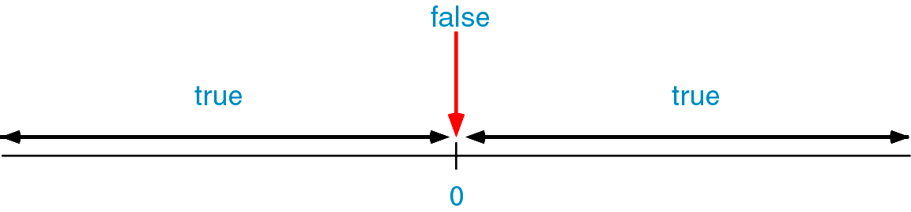
Logical Operators
Logical data have only two values: TRUE or FALSE
If a data value is zero, it is considered false. If it is nonzero, it is considered true.
Zero ≡ FALSE
Nonzero (positive / negative) ≡ TRUE

Slide 35
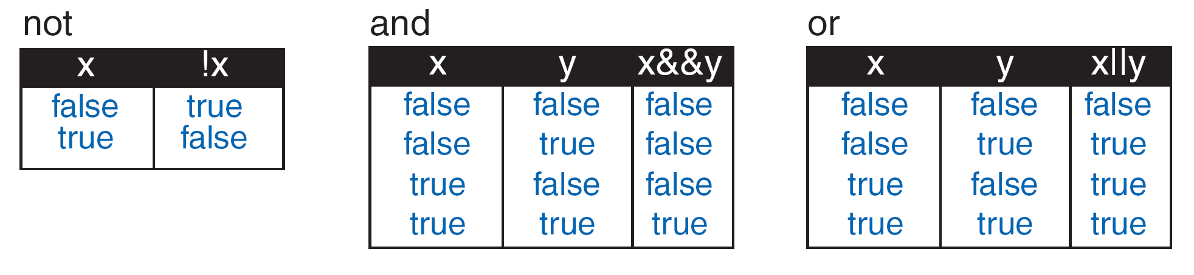
Logical Operator
Logic | Operator
NOT, negation | !
AND | &&
OR | ||
Notes:
BACS1014 Problem Solving and Programming

Slide 36
Logical Operators - Example
if(!(valid_answer))
cout << “invalid”;
if(mark < 0 || mark > 100)
cout << “invalid”;
x = 1;
while(x <= 10) {
cout << x << endl;
x++;
}

Slide 37
Exercise
Given int i = 7, float f = 5.5 and char c = ‘w’
Expression | Meaning
a) f > 5
b) (i + f) <= 10
c) c == 119
d) c != ‘p’
e) c >= 10 * (i +f)
f) (f < 11) && (i > 100)
g) (i >= 6) || (c == 119)
h) !(f > 5)
True
False
True
True
False
False
True
False

Slide 38
Ternary Conditional Operators
An alternative to the if…else for two-way selection.
Format:
expression1 ? expression_A : expression_B
Evaluate the leftmost expression (expression1) first.
If expression1 is TRUE, the value of the conditional expression is the value of expression_A. Otherwise, the value will be the value of expression_B.

Slide 39
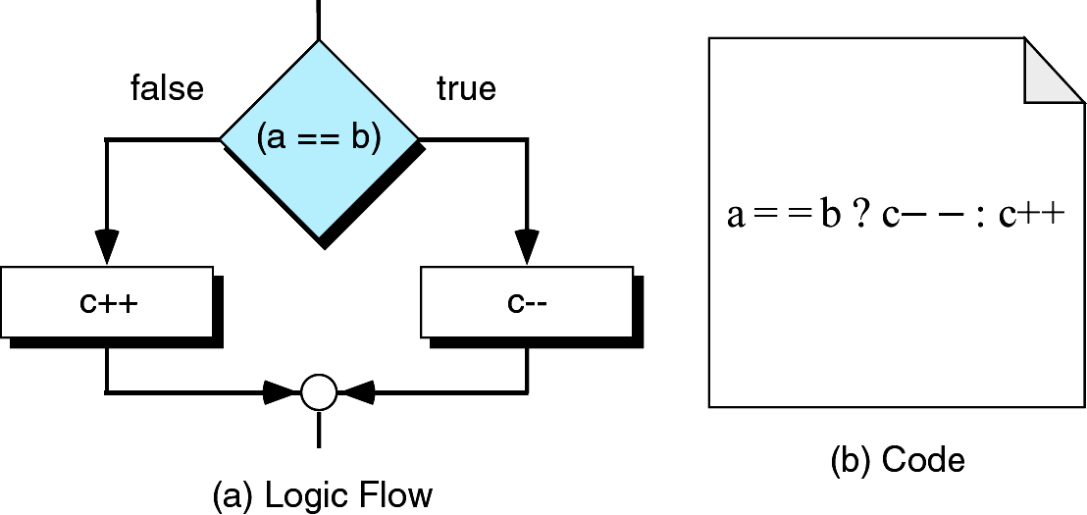
Ternary Conditional Operators
If a equal to b, c-- will be evaluated and c++ will be ignored.
If a not equal to b, c++ will be evaluated and c-- will be ignored.

